Slide 1

mailpile
@MailpileTeam
Bjarni Rúnar Einarsson
GnuPG summit 18.04.2015

Slide 2
What is Mailpile?
An e-mail client: (not a mail server... yet)
    A web based user interface & API
    A powerful search engine
    An easy way to use PGP
Target platforms:
    Windows, Mac & Linux desktops
    Home servers, VPSes, small businesses

Slide 3
Who is Mailpile?
Core team:
    Bjarni Rúnar Einarsson: founder & lead developer
    Brennan Novak: Web UI and visual design
    Smári McCarthy: Security and advocacy
Active communities on Github and Transifex
Only Bjarni currently working “full” time

Slide 4
Mailpile and money
Crowdfunded on IndieGoGo in 2013, raised $163,000 and a bunch of bitcoins
In-kind support from Thoughtworks for Smári's contributions in 2014
In-kind support from Bjarni and Brennan in form of reduced salaries
Grant applications: no luck so far :-(
Sustainability blocked by development delays and lack of (human) resources

Slide 5
Mailpile's history
2011 – Project infancy: e-mail search engine
2012 - (nothing)
2013 – IndieGoGo campaign, full time work!
2014 – Alpha in January, Beta in September
2015 – Beta II...
    …our “beta” labels proved overly optimistic, app was too buggy/incomplete for non-developers. Now aiming for usable release next September.

Slide 6
Is Mailpile weird?
What's different?
    Target audience is non-technical users on common desktop operating systems
    Uses web tech for user interface
    If run on trusted hardware, can access keys but still be used remotely (IPv6, pagekite, Tor, ...)
    Crypto baked in from start
    TOFU trust model, ignoring PGP WoT
    Aiming for incremental security improvements

Slide 7
Mailpile tech stack
Python application
    Local mail & IMAP client
    Custom search & tagging engine
    Built-in web server for API & UI
    GnuPG / OpenSSL for crypto
HTML5/JSON user interface
    Static first (readable without JS)
    Progressive enhancement using Javascript

Slide 8
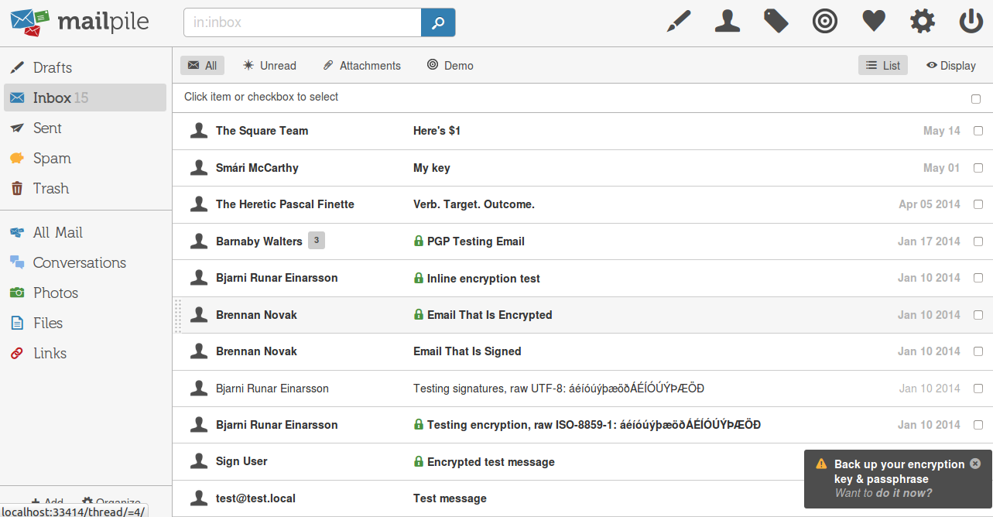
Inbox view

Slide 9
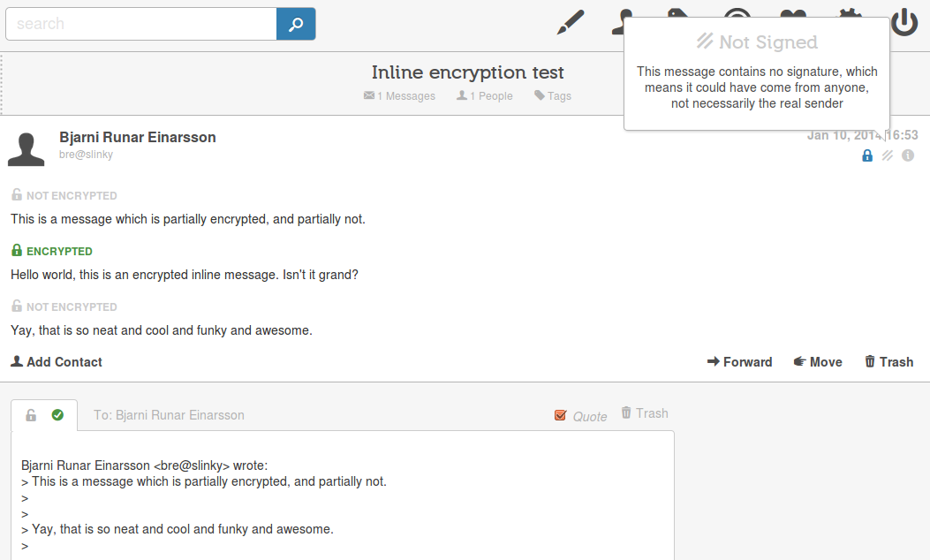
Reading encrypted mail

Slide 10
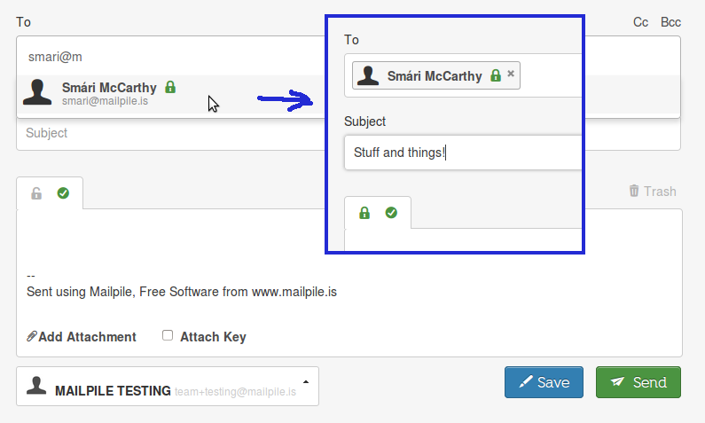
Compose encrypted

Slide 11
Mailpile's challenges
General:
    Funding!
    Building an e-mail client is hard
GnuPG:
    GnuPG 2.x makes some desktop assumtions, stuck on 1.4.x while pondering solutions
    Invoking gpg directly, frustrated by interface

Slide 12
Cool GnuPG stuff
Mailpile's PGP experience is already quite nice... when it works ;-)
Brennan's Modern PGP: spinning off reusable design elements (work-flows, icons)
Ideas to expore:
  Exploring enhanced signatures (manifests) as alternative to PGP/MIME encapsulation
  PGP Angels, fingerprints as colorful avatars

Slide 13
PGP Manifests
Manifest lists and signs:
  Headers
  Order and SHA2 of all attachments/parts
  Can be encrypted or clear-text
Benefits?
  Headers can be signed (or encrypted)
  Compatible with legacy copy-paste workflows
  Compatible with browser plugins for web-mail

Slide 14
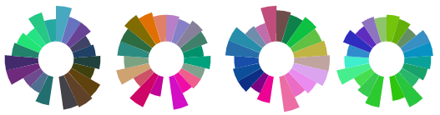
PGP Angels
Goals:
  Make PGP pretty!
  Help user's notice key changes
How:
  Derive from fingerprint
  Color and shape
  80-100 bits “visible”

Slide 15
www.mailpile.is

